Slide 1
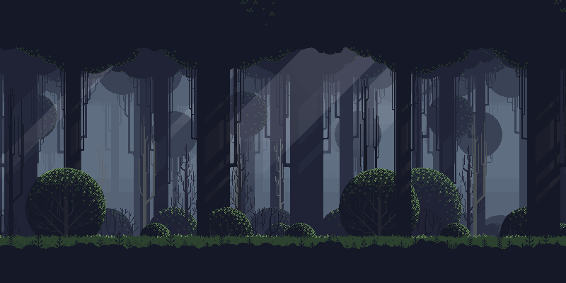





UNDER MAINTENANCE
POWERED BY:

Slide 2
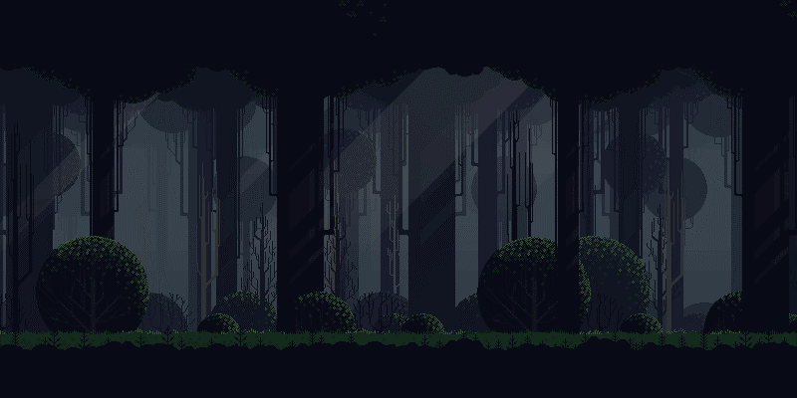
MAIN MENU
OUR TEAM:
KEVIN SIMORANGKIR
FERREYLA SETARA IBN
IGNATIUS KRISNA ISSAPUTRA
M. RIZKI ALFAINA
RIZKA FAUZIYAH
NUR HIKMAH JULIYANTI
POWERED BY:

Slide 3
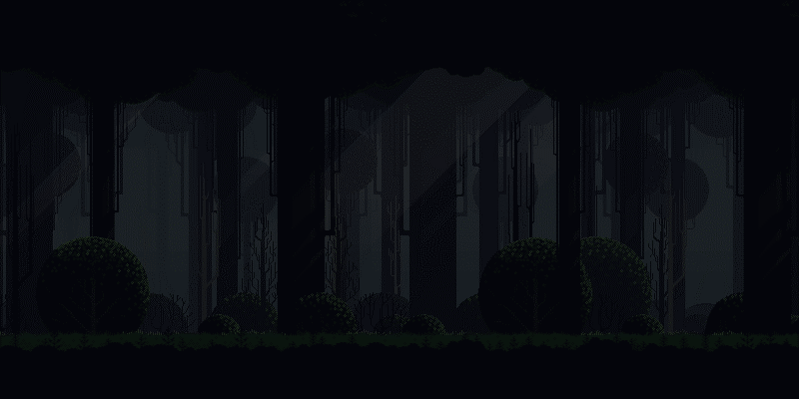

MAIN MENU
Dalam game ini, kami menghadirkan pengalaman permainan yang menggabungkan elemen grafis pixelated dengan sistem pertarungan turn based. Karakter utama dalam game ini akan berhadapan dengan sejumlah musuh yang harus dilawan secara bergantian.
POWERED BY:

Slide 4


MAIN MENU
Baik pemain maupun musuh akan memiliki basic attack yang mengurangi health point. Namun, tidak hanya basic attack, terdapat kemampuan heal menggunakan potion. Namun, penting untuk dicatat bahwa potion yang tersedia dalam game ini memiliki jumlah yang terbatas, sehingga pemain harus mengelola penggunaannya dengan bijak.
POWERED BY:

Slide 5

MAIN MENU
PROGRAM PREVIEW
POWERED BY:

Slide 6
Bagian ini merupakan pendeklarasian gambar latar pada game ini pada modul ”Enemy_Hero”
pygame.init()
clock = pygame.time.Clock()
fps = 60
#game window
bottom_panel = 150
screen_width = 800
screen_height = 400 + bottom_panel
screen = pygame.display.set_mode((screen_width, screen_height))
pygame.display.set_caption('Battle')
#create function for drawing text
def draw_text(text, font, text_col, x, y):
img = font.render(text, True, text_col)
screen.blit(img, (x, y))
POWERED BY:

Slide 7
Bagian ini merupakan pendeklarasian gambar latar pada game ini pada modul ”Enemy_Hero”
#function for drawing background
def draw_bg():
screen.blit(asset.background_img, (0, 0))
#function for drawing panel
def draw_panel():
#draw panel rectangle
screen.blit(asset.panel_img, (0, screen_height - bottom_panel))
#show knight stats
draw_text(f'{knight.name} HP: {knight.hp}', asset.font, asset.red, 100, screen_height - bottom_panel + 10)
for count, i in enumerate(bandit_list):
#show name and health
draw_text(f'{i.name} HP: {i.hp}', asset.font, asset.red, 550, (screen_height - bottom_panel + 10) + count * 60)
POWERED BY:

Slide 8
Setelah pendeklarasian objek, maka termasuk pendeklarasian image attack, idle, death, dan hurt
for i in range(8):
img = pygame.image.load(f'img/{self.name}/Idle/{i}.png')
img = pygame.transform.scale(img, (img.get_width() * 3, img.get_height() * 3))
temp_list.append(img)
self.animation_list.append(temp_list)
# load attack images
temp_list = []
for i in range(8):
img = pygame.image.load(f'img/{self.name}/Attack/{i}.png')
img = pygame.transform.scale(img, (img.get_width() * 3, img.get_height() * 3))
temp_list.append(img)
self.animation_list.append(temp_list)
# load hurt images
temp_list = []
for i in range(3):
img = pygame.image.load(f'img/{self.name}/Hurt/{i}.png')
POWERED BY:

Slide 9
Setelah pendeklarasian objek, maka termasuk pendeklarasian image attack, idle, death, dan hurt
img = pygame.transform.scale(img, (img.get_width() * 3, img.get_height() * 3))
temp_list.append(img)
self.animation_list.append(temp_list)
# load death images
temp_list = []
for i in range(10):
img = pygame.image.load(f'img/{self.name}/Death/{i}.png')
img = pygame.transform.scale(img, (img.get_width() * 3, img.get_height() * 3))
temp_list.append(img)
self.animation_list.append(temp_list)
self.image = self.animation_list[self.action][self.frame_index]
self.rect = self.image.get_rect()
self.rect.center = (x, y)
POWERED BY:

Slide 10
Pendeklarasian pengurangan darah dan efek suara pada method diatas
def attack(self, target):
# deal damage to enemy
rand = random.randint(-5, 5)
damage = self.strength + rand
target.hp -= damage
# run enemy hurt animation
target.hurt()
asset.attackbandit_sound.play()
# check if target has died
if target.hp < 1:
target.hp = 0
target.alive = False
target.death()
damage_text = DamageText(target.rect.centerx, target.rect.y, str(damage), asset.red)
damage_text_group.add(damage_text)
# set variables to attack animation
self.action = 1
self.frame_index = 0
self.update_time = pygame.time.get_ticks()
POWERED BY:

Slide 11
Pendeklarasian pengurangan darah dan efek suara pada method diatas
def hurt(self):
# set variables to hurt animation
self.action = 2
asset.gethurt_bandit.play()
self.frame_index = 0
self.update_time = pygame.time.get_ticks()
def death(self):
# set variables to death animation
self.action = 3
asset.death_bandit.play()
self.frame_index = 0
self.update_time = pygame.time.get_ticks()
def reset(self):
self.alive = True
self.potions = self.start_potions
self.hp = self.max_hp
self.frame_index = 0
self.action = 0
self.update_time = pygame.time.get_ticks()
POWERED BY:

Slide 12
Healthbar dan damage text sebagai add on
apabila terjadi penambahan darah pada potion dan jika terkena hit
lass HealthBar(ABC):
def __init__(self, x, y, hp, max_hp):
self.x = x
self.y = y
self.hp = hp
self.max_hp = max_hp
@abstractmethod
def draw(self, hp):
pass
class ConcreteHealthBar(HealthBar):
def draw(self, hp):
# update with new health
self.hp = hp
# calculate health ratio
ratio = self.hp / self.max_hp
pygame.draw.rect(screen, asset.red, (self.x, self.y, 150, 20))
pygame.draw.rect(screen, asset.green, (self.x, self.y, 150 * ratio, 20))
POWERED BY:

Slide 13
Healthbar dan damage text sebagai add on
apabila terjadi penambahan darah pada potion dan jika terkena hit
class DamageText(pygame.sprite.Sprite):
def __init__(self, x, y, damage, colour):
pygame.sprite.Sprite.__init__(self)
self.image = asset.font.render(damage, True, colour)
self.rect = self.image.get_rect()
self.rect.center = (x, y)
self.counter = 0
def update(self):
# move damage text up
self.rect.y -= 1
# delete the text after a few seconds
self.counter += 1
if self.counter > 30:
self.kill()
POWERED BY:

Slide 14
Pemanggilan fungsi untuk ditampilkan pada layar
damage_text_group = pygame.sprite.Group()
asset = asset.Game()
knight = Knight(200, 260, 'Knight', 30, 10, 3)
bandit1 = Bandit(550, 270, 'Bandit', 20, 6, 1)
bandit2 = Bandit(700, 270, 'Bandit', 20, 6, 1)
bandit3 = Bandit(400, 270, 'Bandit', 20, 6, 1)
bandit_list = []
bandit_list.append(bandit1)
bandit_list.append(bandit2)
bandit_list
POWERED BY:

Slide 15
asset sound dan proses dalam gerakan game disimpan di module asset class game
import pygame
class Game:
def __init__(self):
# Game variables
self.current_fighter = 1
self.total_fighters = 3
self.action_cooldown = 0
self.action_wait_time = 90
self.attack = False
self.potion = False
self.potion_effect = 15
self.clicked = False
self.game_over = 0
# Define fonts
self.font = pygame.font.SysFont('Times New Roman', 26)
# Define colors
self.red = (255, 0, 0)
self.green = (0, 255, 0)
POWERED BY:

Slide 16
asset sound dan proses dalam gerakan game disimpan di module asset class game
# Load images
# Background image
self.background_img = pygame.image.load('img/Background/background.png').convert_alpha()
# Panel image
self.panel_img = pygame.image.load('img/Icons/panel.png').convert_alpha()
# Button images
self.potion_img = pygame.image.load('img/Icons/potion.png').convert_alpha()
self.restart_img = pygame.image.load('img/Icons/restart.png').convert_alpha()
# Load victory and defeat images
self.victory_img = pygame.image.load('img/Icons/victory.png').convert_alpha()
self.defeat_img = pygame.image.load('img/Icons/defeat.png').convert_alpha()
# Sword image
self.sword_img = pygame.image.load('img/Icons/sword.png').convert_alpha()
POWERED BY:

Slide 17
asset sound dan proses dalam gerakan game disimpan di module asset class game
self.attackknight_sound = pygame.mixer.Sound('sound\swinging-staff-whoosh-strong-08-44658.wav')
self.attackbandit_sound = pygame.mixer.Sound('sound\mixkit-dagger-woosh-1487.wav')
self.gethurt_knight = pygame.mixer.Sound('sound\Studio_Project_V1.wav')
self.backsound = pygame.mixer.Sound('sound\inibacksound.wav')
self.healup = pygame.mixer.Sound('sound\heal-up.wav')
self.gethurt_bandit = pygame.mixer.Sound('sound\suarabandit.wav')
self.death_bandit = pygame.mixer.Sound('sound\matibandit1.wav')
self.death_knight = pygame.mixer.Sound('sound\matiknight1.wav')
POWERED BY:

Slide 18
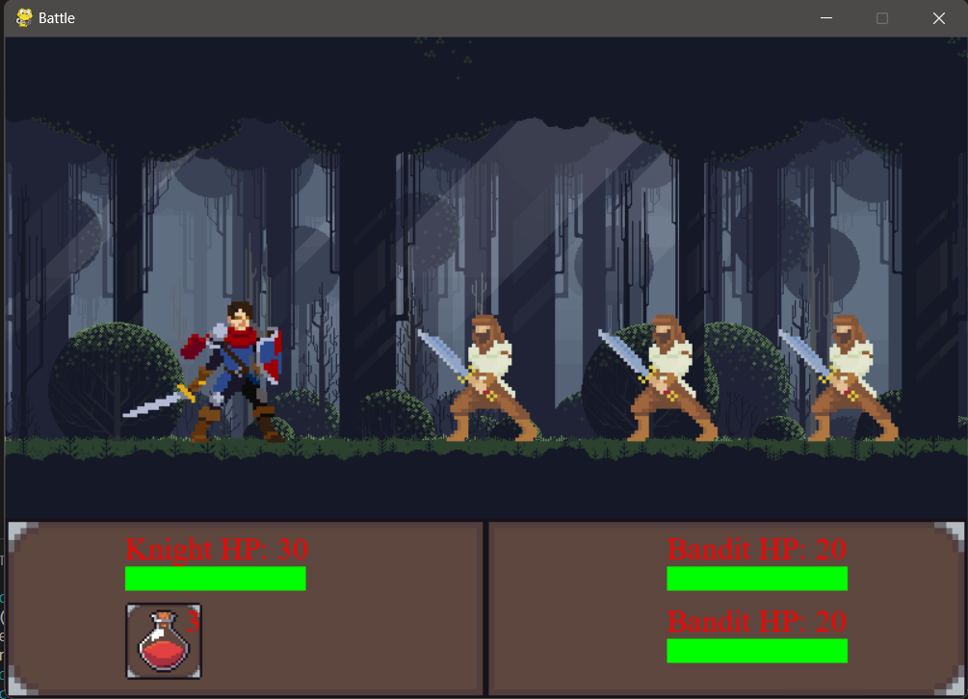
PREVIEW INGAME
MAIN MENU

Slide 19
PREVIEW INGAME
MAIN MENU

